Slide 1
Complete & Connected: Tools for Planning a Balanced Transportation System Technical Workshop

Slide 2
Traditional “Planning”
Goals
Policies, Programs, Projects

Slide 3
Strategic Planning Process
Vision
Goals
Objectives
Measures, Indicators
Policies, Programs, Projects
Performance Reporting

Slide 4
Traditional Transportation Planning (“Predict and Provide”)
Forecast Traffic
Traffic Grows
Widen Roads

Slide 5
Traditional Transportation Planning (“Predict and Provide”)
Forecast Traffic
Traffic Grows
Widen Roads

Slide 6
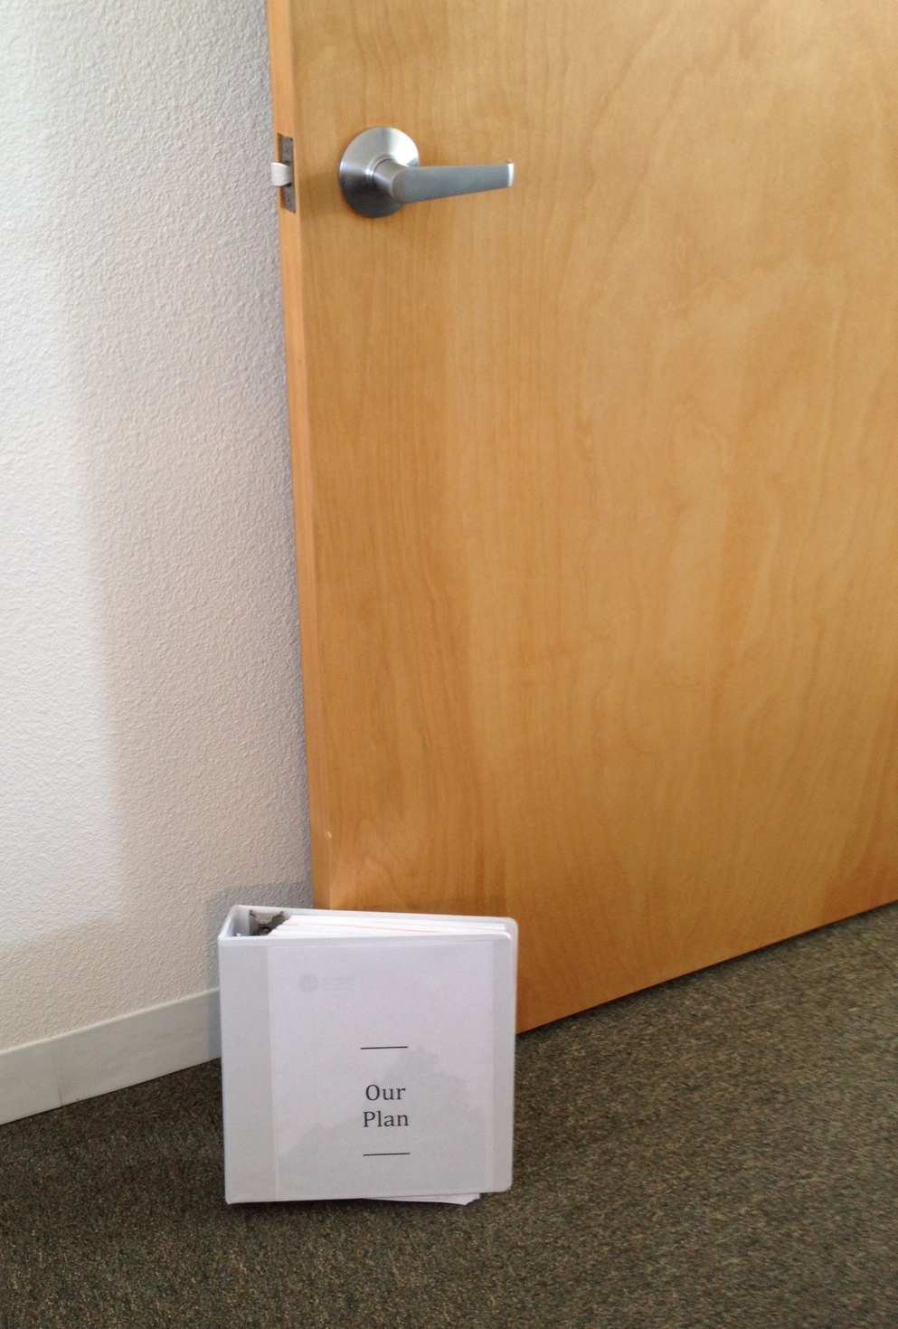
How some plans are used

Slide 7
Avoiding Plan-gormortis
Implementation Actions
Action*
Cost
Lead
Years 1 - 3
xxx
xxx
xxx
Years 4 - 7
xxx
xxx
xxx
Years 8 - 20
xxx
xxx
xxx
“Action” – project, ordinance, plan, agreement, grant

Slide 8
Plan Types

Slide 9
Scenario Planning
Alternative Land Use Patterns
Supporting Transportation Programs
Transportation Projects, Policies, Etc.
Program Evaluation (Forecasts)
Land Use Scenario A
Trans Plan
A
Project List
A
Evaluation Criteria
Land Use Scenario B
Trans Plan
B
Project List
B
Evaluation Criteria
Land Use Scenario B
Trans Plan
C
Project List
C
Evaluation Criteria

Slide 10
Build Out Planning
Build Out Land Development Pattern
Alternative Transportation Systems
Transportation Projects, Policies, Etc.
Forecast
System
Performance
Single
Land Use Scenario
Trans Plan
A
Project List
A
Evaluation Criteria
Trans Plan
B
Project List
B
Evaluation Criteria
Trans Plan
C
Project List
C
Evaluation Criteria

Slide 11
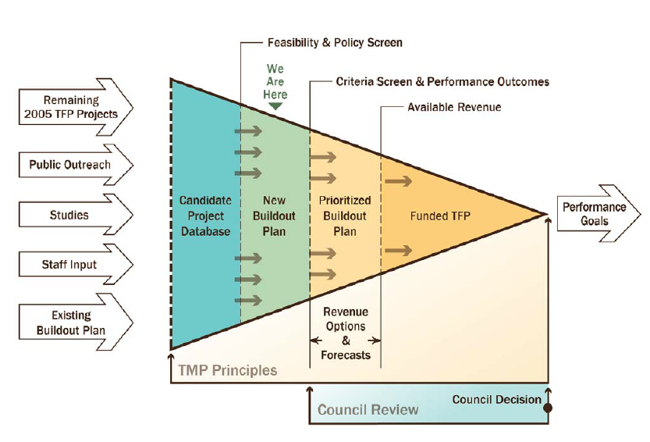
Redmond Example

Slide 12
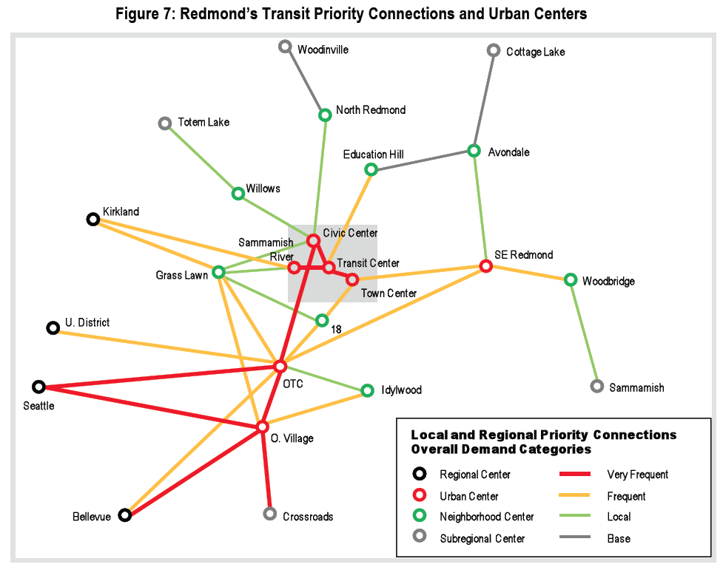

Slide 13
Goal-Based Planning
Build Out Land Development Pattern
Mobility and Access Goals and Objectives
Transportation Projects, Policies, Etc.
Forecast
System
Performance
Single
Land Use Scenario
Goal
A
Project List
A
Evaluation Criteria
Goal
B
Project List
B
Evaluation Criteria
Goal
C
Project List
C
Evaluation Criteria

Slide 14
Example: Iowa DOT
Mission:
The Iowa Department of Transportation advocates and delivers transportation services that support the economic, environmental and social vitality of Iowa.
Goal 1 - Improve the safety of Iowa’s transportation systems
Goal 2 - Improve the quality of Iowa’s transportation systems and what they provide
Goal 3 – Improve internal and external customer service
Goal 4 – Improve the effectiveness of our workplaces

Slide 15
Example: Iowa DOT
Goal 2:
Improve the quality of Iowa’s transportation systems and what they provide.
Measures for Goal 2:
Measure – Sufficiency rating
Measure – Pavement Condition Index (PCI) value for various classes
Measure – Functionally obsolete and structurally deficient bridges
Measure – Centerline miles of ‘key corridors’ programmed
Measure – Miles of interstate highway at established levels of service
Measure – Average annual combined wage rate of RISE supported jobs as
compared to average county wages rates
Measure – Total business capital investment associated with RISE projects
(leveraged)

Slide 16
Example: Iowa DOT
Goal 2:
Improve the quality of Iowa’s transportation systems and what they provide.
Strategies for Goal 2:
Strategy – Secure sufficient funding
Strategy – Develop a passenger rail program
Strategy – Maximize processes for efficiency and prudent decision-making
Strategy – Develop a transportation system and services performance
management program

Slide 17
What gets measured gets done

Slide 18

Thank You

